Slide 1
Computer Networks
Stop and Wait and Sliding window concepts

Slide 2
What is Stop and Wait ARQ?
The Stop and Wait ARQ protocol sends a data frame and then waits for an acknowledgment (ACK) from the receiver. The ACK indicates that the receiver successfully received the data frame. After receiving the ACK from the receiver, the sender delivers the next data frame. So there is a stop before the next data frame is transferred, hence it is known as the Stop and Wait ARQ protocol.
Used in Connection-oriented communication.
It offers error and flow control
It is used in Data Link and Transport Layers

Slide 3
Useful terms in ARQ stop & wait
Propagation Delay
Propagation delay in stop-and-wait protocol refers to the time taken for a signal to travel from the sender to the receiver, affecting the overall transmission time of a single data frame.
Round Trip Time (RTT) in stop-and-wait protocol is the time taken for a data frame to be sent from the sender to the receiver and for the acknowledgment to be received back at the sender.
Time To Live (TTL) in stop-and-wait protocol refers to the maximum amount of time a data frame is allowed to remain in the network before being discarded.

Slide 4
Stop and Wait
At Sender
1) Send one data packet at a time.
2) Send the next packet only after receiving acknowledgment for the previous.
At Receiver
1) Send acknowledgement after receiving and consuming a data packet.
2) After consuming packet acknowledgement need to be sent

Slide 5
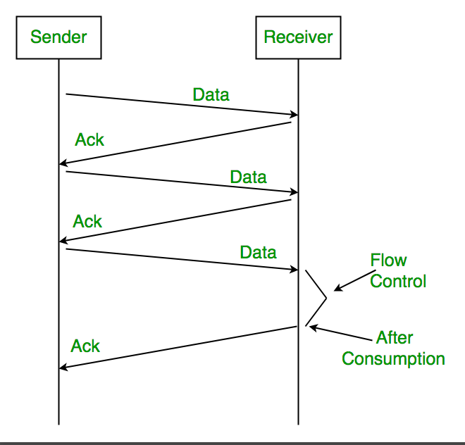
Stop and Wait

Slide 6
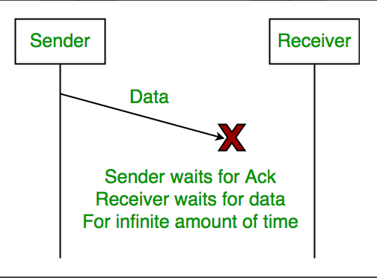
Problems Associated with Stop and Wait
1. Lost Data
Assume the sender transmits the data packet and it is lost. The receiver has been waiting for the data for a long time. Because the data is not received by the receiver, it does not transmit an acknowledgment. The sender does not receive an acknowledgment, it will not send the next packet. This problem is caused by a loss of data.

Slide 7
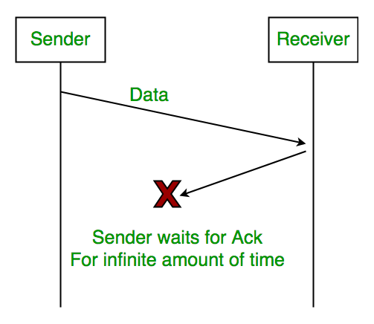
Problems Associated with Stop and Wait
2. Lost Acknowledgement Assume the sender sends the data, which is also received by the receiver. The receiver sends an acknowledgment after receiving the packet. In this situation, the acknowledgment is lost in the network. The sender does not send the next data packet because it does not receive acknowledgement, under the stop and wait protocol, the next packet cannot be transmitted until the preceding packet’s acknowledgment is received.

Slide 8
Problems Associated with Stop and Wait
3. Delayed Acknowledgement/Data
Assume the sender sends the data, which is also received by the receiver. The receiver then transmits the acknowledgment, which is received after the sender’s timeout period. After a timeout on the sender side, a long-delayed acknowledgement might be wrongly considered as acknowledgement of some other recent packet.

Slide 9
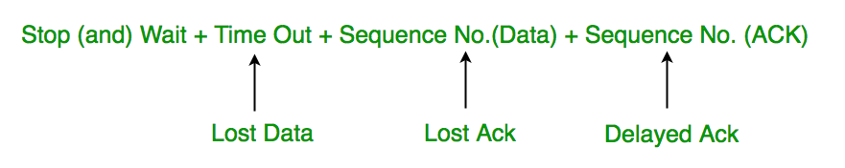
Stop and Wait for ARQ (Automatic Repeat Request)
The above 3 problems are resolved by Stop and Wait for ARQ (Automatic Repeat Request) that does both error control and flow control.

Slide 10
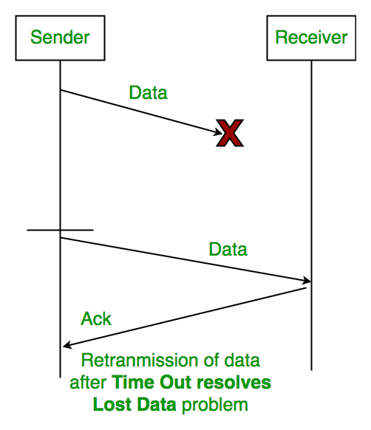
1. Time Out
Timeout refers to the duration for which the sender waits for an acknowledgment (ACK) from the receiver after transmitting a data packet. If the sender does not receive an ACK within this timeout period, it assumes that the frame was lost or corrupted and retransmits the frame.

Slide 11
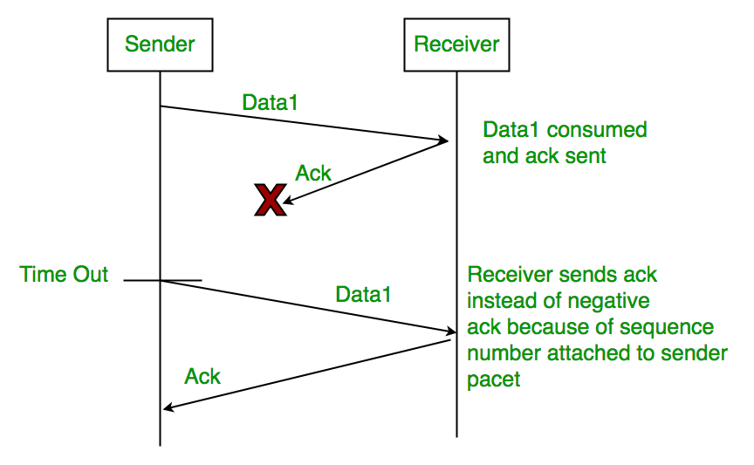
Sequence Number (Data)
In Stop-and-Wait ARQ, the sender assigns sequence numbers to each data frame it sends. This allows the receiver to identify and acknowledge each frame individually, ensuring reliable delivery of data packets. After sending a frame, the sender waits for an acknowledgment before sending the next frame.

Slide 12
3. Sequence Number(Acknowledgement)
Similarly, sequence numbers are also used in acknowledgments (ACKs) sent by the receiver to acknowledge received data frames. When the receiver successfully receives a data frame, it sends an ACK back to the sender, indicating the sequence number of the next expected frame. The sender uses this ACK to determine whether the transmission was successful and whether it can proceed to send the next frame.

Slide 13
Sliding Window Protocol
The Stop and Wait ARQ offers error and flow control but may cause big performance issues as the sender always waits for acknowledgment even if it has the next packet ready to send. Consider a situation where you have a high bandwidth connection and propagation delay is also high (you are connected to some server in some other country through a high-speed connection), you can’t use this full speed due to limitations of stop and wait.
Sliding Window protocol handles this efficiency issue by sending more than one packet at a time with a larger sequence number. The idea is the same as pipelining in architecture.

Slide 14
Types of Sliding Window Protocol
There are two types of Sliding Window Protocol which include Go-Back-N ARQ and Selective Repeat ARQ:
Go-Back-N ARQ
Go-Back-N ARQ allows sending more than one frame before getting the first frame’s acknowledgment. It is also known as sliding window protocol since it makes use of the sliding window notion. There is a limit to the amount of frames that can be sent, and they are numbered consecutively. All frames beginning with that frame are retransmitted if the acknowledgment is not received in a timely manner. For more detail visit the page Go-Back-N ARQ.
Selective Repeat ARQ
Additionally, this protocol allows additional frames to be sent before the first frame’s acknowledgment is received. But in this case, the excellent frames are received and buffered, and only the incorrect or lost frames are retransmitted. Check the detailed explanation of Selective Repeat ARQ.

Slide 15
In summary, Go-Back-N ARQ retransmits multiple frames upon a timeout or receipt of a NAK, while Selective Repeat ARQ selectively retransmits only the necessary frames. Selective Repeat ARQ is generally more efficient but more complex to implement compared to Go-Back-N ARQ.

Slide 16
Solution of problems
The sliding window concept primarily addresses two key problems in data communication:
Flow Control: Sliding window protocols are used to regulate the flow of data between sender and receiver in a network. By allowing the sender to transmit a certain number of packets before requiring an acknowledgment from the receiver, sliding window protocols help optimize data transfer efficiency and prevent overwhelming the receiver with too much data.
Acknowledgment and Retransmission: Sliding window protocols facilitate reliable data transmission by employing acknowledgments and selective repeat or go-back-N strategies for retransmitting lost or corrupted packets. This helps ensure that data is successfully delivered to the receiver, even in the presence of network errors or congestion.

Slide 17
Summary
Sliding window protocol and stop-and-wait are both techniques used in data transmission over networks. Sliding window protocol offers several advantages over stop-and-wait. Unlike stop-and-wait, where each frame must be acknowledged before the next is sent, sliding window allows multiple frames to be in transit simultaneously, maximizing bandwidth utilization.
This reduces idle time and improves efficiency, especially over high-latency connections. Sliding window also supports bi-directional communication, enabling both sender and receiver to transmit data concurrently. Additionally, it offers error recovery mechanisms such as selective repeat or go-back-N, enhancing reliability in the face of packet loss. Overall, sliding window protocol provides increased throughput and better resource utilization compared to stop-and-wait, making it a preferred choice in many network scenarios.

